Slide 1



Database Management System
Grocery List Home Application
Attia Batool
06 May, 2025

Slide 2


Problem Statement
01
Manual tracking = Errors, missing stock, poor records.
02
No category-wise or expense tracking for shopkeepers
03
Need for a simple, database-driven inventory solution.

Slide 3

Project Objectives
01
Design a database to manage grocery items. Enable users to add, view, and delete their items.
02
Generate reports by category and expense.
03
Implement real DBMS concepts with a web app.

Slide 4

Tools & Technologies
Frontend: HTML, CSS
Backend: PHP
Database: MySQL
Server: XAMPP (Apache + MySQL)

Slide 5
Methodology
Requirement Analysis
Database Design
Identified the core needs: item tracking, user login, category-wise organization, and expense reporting for effective grocery management.
Designed a normalized relational database (grocery_db) with four tables: users, items, categories, and expense_reports, ensuring data integrity and logical relationships.
Backend & Frontend Development
Testing & Deployment
Implemented user sessions, item operations (Add/View/Delete), and category analytics using PHP (backend) and MySQL, with a simple HTML/CSS frontend.
Verified functionalities like login flow, data insertion, report generation, and logout under various test cases using XAMPP for local deployment.

Slide 6
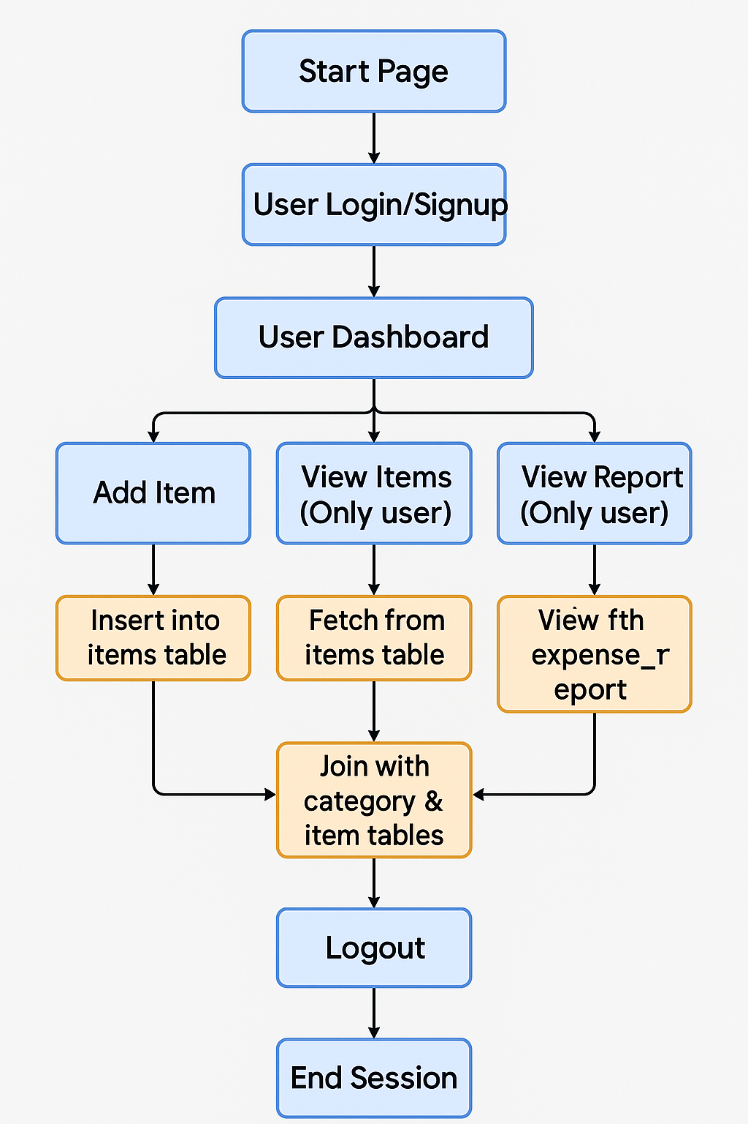
Flow of My Project

Slide 7
Results
Items are properly inserted, displayed, and deleted from the MySQL database.
I successfully applied Insert, Select, Delete, and Count queries.
Implemented session-based login/logout system.
Displayed grocery data dynamically from the database.
Category analysis helps visualize which items are most used.

Slide 8
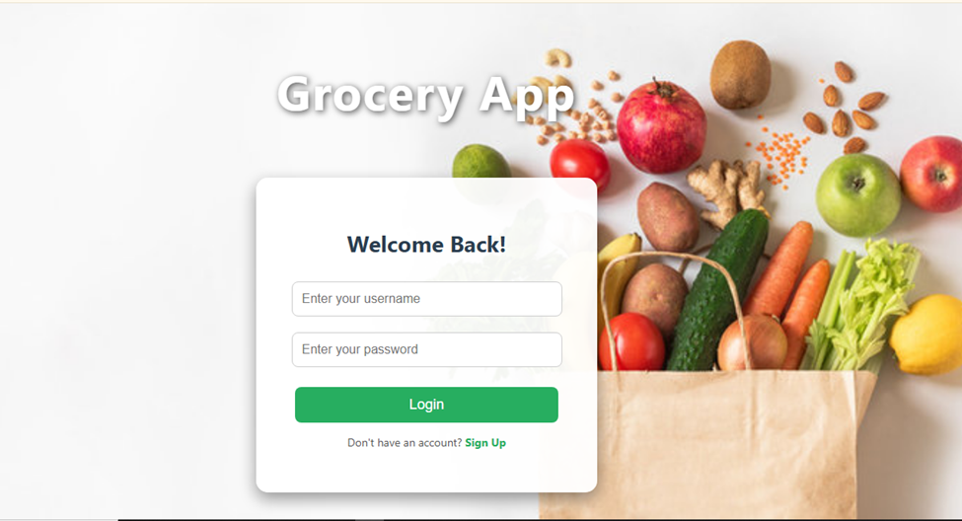
login_signup_page

Slide 9
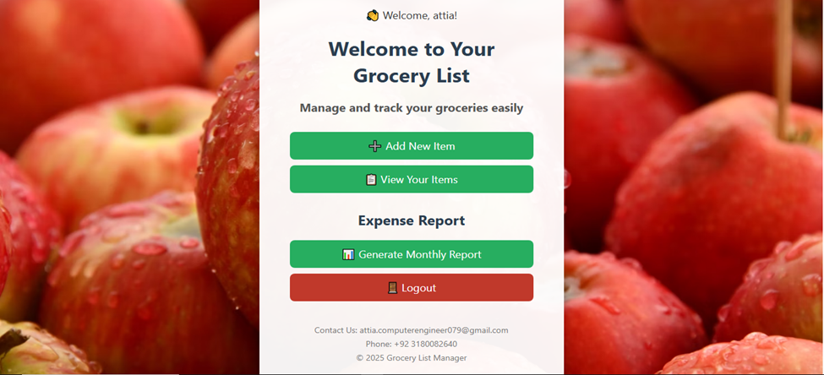
Home_Dashboard

Slide 10
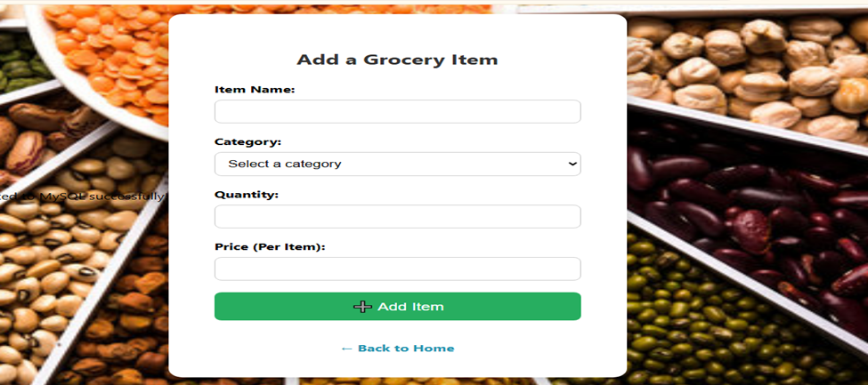
Add_items_page

Slide 11
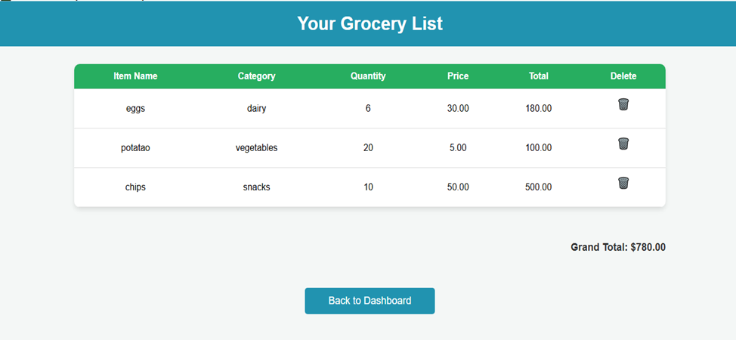
view_items_page

Slide 12
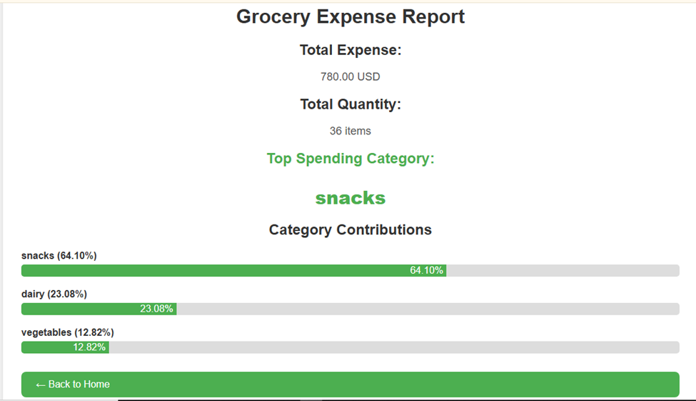
Reports_page

Slide 13

Applications
Small Retail Stores & Kirana Shops
01
Helps shopkeepers track stock, manage categories, and avoid over/under-ordering—leading to better inventory control and reduced waste.
02
Household Grocery Management
Families can manage their grocery items digitally, track usage patterns, and analyze monthly expenses easily without forgetting what to buy.

Slide 14
Conclusion & Future Work
01
A practical DBMS project with real-world use
02
Strengthened database and backend logic skills
03
Add update item feature, Password-based login, Visual category charts

Slide 15

Thank You

